Slide 1
Module 7 Guidance Notes Structs, File I/O & Recursion
ENGG1340/COMP2113 Computer Programming II/Programming Technologies

Slide 2
Before We Start
There are altogether 3 parts:
Structs – We’ve learned about the basic C/C++ built-in data types. With structs, you can define your own compound data type to facilitate data handling. We will also briefly touch upon C++ class which can be considered as an encapsulation of some data together with the operations allowed on the data.
File I/O – This is for reading and writing of data to a file external to your program which can be stored permanently on a hard drive. You will also learn about string stream as well as some I/O formatting here.
Recursion – Recursion is a very powerful method for solving a problem. If your solution to a problem can be defined in a smaller version (i.e., one that accepts a smaller input) of itself, then likely you can write a recursive function for it. A recursion function is usually simple and can thus enhance readability, but sometimes you will need to take note of its runtime complexity.
<number>

Slide 3
Before We Start
We will deal with C++ only in this module.
Important: We will be using the C++ 11 standard, so make sure that your compiler option is set appropriately. We suggest to use the following command to compile your C++ program:
g++ -pedantic-errors -std=c++11 your_program.cpp
The -pedantic-errors flag is to make sure that your code conforms to the ISO C/C++ standard. We will enforce this in your assignment submission too. For more information about C/C++ standards, you may read https://en.wikipedia.org/wiki/ANSI_C and https://isocpp.org/std/the-standard
<number>

Slide 4
How to Use this Guidance Notes
This guidance notes aim to lead you through the learning of the C/C++ materials. It also defines the scope of this course, i.e., what we expect you should know for the purpose of this course. (and which should not limit what you should know about C/C++ programming.)
Pages marked with “Reference Only” means that they are not in the scope of assessment for this course.
The corresponding textbook chapters that we expect you to read will also be given. The textbook may contain more details and information than we have here in this notes, and these extra textbook materials are considered references only.
<number>

Slide 5
How to Use this Guidance Notes
We suggest you to copy the code segments in this notes to the coding environment and try run the program yourself.
Also, try make change to the code, then observe the output and deduce the behavior of the code. This way of playing around with the code can help give you a better understanding of the programming language.
<number>

Slide 6
References
You may want to check out the following supplementary readings:
Book Chapters
Problem Solving with C++
Ch. 10.1 (structs)
Ch. 6.1-6.2 (File I/O)
Ch. 14 (recursion)
From C++ tutorials
Structures
File I/O
<number>

Slide 7
Topics
Part I: Structs
Part II: File I/O
Part III: Recursion
<number>
Notes:
<number>

Slide 8
Part I
STRUCTS
<number>

Slide 9
Structures
A structure is a collection of one or more variables grouped together under a single name
The data elements in a structure are known as its member variables (or simply members), which can be of different types
Structures help organizing complex data
Allow a group of related variables to be treated as a single unit instead of separate entities
Structures act like any basic data type
May be copied and assigned to variables
May be passed to and returned by functions
Student Record
uid (int)
assign 1 marks (int)
assign 2 marks (int)
quiz 1 marks (int)
quiz 2 marks (int)
final marks (int)
total marks (double)
grade (char)
<number>
Notes:
<number>

Slide 10
Definition
In C++, a structure is defined using the keyword struct, followed by a structure tag, a list of member variables (with types and identifiers) enclosed within a pair of braces { }, and a semicolon ;
Keyword to specify that this is a structure
struct Point {
double x;
double y;
};
struct Student {
int id;
string name;
char sex;
};
Name of the structure
Members of the structure
Must end with a ;
<number>
Notes:
<number>

Slide 11
Definition
Examples
struct Product {
int productID;
double price;
};
struct Point {
double x;
double y;
};
struct Circle {
double x, y;
double r;
};
member variables
Members of different structures can have the same name
<number>

Slide 12
Declaration
Structure variables can be declared just as what you do for the basic data types (e.g., int, char)
struct data type
x
p1
y
Point p1;
Student s1, s2;
id
s1
name
sex
variable names
id
s2
name
sex
memory
<number>

Slide 13
Initialization
A structure variable can be initialized in its declaration:
Point p1 = { 1.0, 2.0 };
Student s1 = { 301323549, "Amy Siu", 'F' };
Student s2 = s1;
Can be initialized with another variable of the same structure data type
Order of the members must be the same as that specified in the definition
Point p2 = { 1.0, 2.0, 3.0 };
Point p3 = { 1.0 };
✗
A compilation error will be generated, since there are more values than the number of members
There are fewer values than the number of members, remaining variables are set to zero of their data type.
(x = 1.0, y = 0.0 )
<number>

Slide 14
Member Variables
A member variable can be used just as other variables of the basic data types
We may use the dot operator . to access the member variables of a structure
What are the values of all the member variables?
Point pt1 = { 1.0, 2.0 };
Point pt2 = pt1;
pt1.x *= 2.0; // pt1.x = pt1.x * 2.0
pt1.y /= 2.0; // pt1.y = pt1.y / 2.0
pt2.x++; // pt2.x = pt2.x + 1
pt2.y--; // pt2.y = pt2.y – 1
result
pt1.x = 2.0
pt1.y = 1.0
pt2.x = 2.0
pt2.y = 1.0
the dot operator
Student s1 = { 301323549, "Amy Siu", 'F' };
int l = s1.name.length();
What is the value of l?
l = 7
a string variable
<number>

Slide 15
Member Variables
What is the data type of each of the following?
s1.id
s1.sex
s1.name
s1
Student.GPA
s1.GPA
s2.GPA
Example
struct Student {
int id;
string name;
char sex;
double GPA;
};
Student s1;
int
char
string
Student
invalid. Student is a data type, not a variable
double
invalid. s2 is undeclared.
<number>

Slide 16
Operators
Structure variables do not work with arithmetic (+/-), relational (>/<), equality (==) and logical operators (&&/||) by default
because struct is user-defined
All expressions below are therefore invalid
Point pt1 = {1.0, 2.0}, pt2 = {3.0, 5.0};
Point pt3 = pt1 + pt2;
bool b = pt1 > pt2;
bool c = pt1 == pt2;
bool d = pt1 && pt2;
✗
The only operator that we may use is the assignment (=) operator
<number>

Slide 17
Assignment
The assignment operator = can be used for copying a struct to another
Example:
Point p1 = {1.0, 2.0}, p2;
p2 = p1;
is equivalent to
p2.x = p1.x;
p2.y = p2.y;
Point p1 = {1.0, 2.0}, p2;
p2.x = p1.y;
p2.y = p1.x;
p1 = p2;
cout << p1.x << ' ' << p1.y << endl;
Screen output
2 1
<number>

Slide 18
Nested Structures
Structures can be nested, which means that a structure can be a member of another structure
Examples:
tr1.p1.x = 1.0
tr1.p1.y = 2.0
tr1.p2.x = 3.0
tr1.p2.y = 4.0
tr1.p3.x = 5.0
tr1.p3.y = 6.0
tr2.p1.x = 1.0
tr2.p1.y = 2.0
tr2.p2.x = 3.0
tr2.p2.y = 4.0
tr2.p3.x = 5.0
tr2.p3.y = 6.0
struct Triangle {
Point p1, p2, p3;
};
Triangle tr1 = {{1.0, 2.0}, {3.0, 4.0}, {5.0, 6.0}};
Triangle tr2 = {1.0, 2.0, 3.0, 4.0, 5.0, 6.0};
tr2.p1.x += tr1.p2.x;
tr2.p1.y += tr1.p2.y;
tr2.p2 = tr1.p3;
tr2.p1.x = 4.0
tr2.p1.y = 6.0
tr2.p2.x = 5.0
tr2.p2.y = 6.0
<number>

Slide 19
Reference Only
Size of Structure
struct structA
{
char c;
double d;
int s;
};
struct structB
{
double d;
int s;
char c;
};
The memory size needed for a structure may not necessarily be the total memory sizes of its variables, and the memory size may differ depending on the order of the variables too!
Try out struct_size.cpp
int main()
{
cout << "sizeof(structA) = " << sizeof(struct structA) << endl;
cout << "sizeof(structB) = " << sizeof(struct structB) << endl;
return 0;
}
Given that the sizes of char, int, double are 1, 4, 8 bytes, respectively, what are the sizes of structA and structB?
<number>

Slide 20
Reference Only
Size of Structure
struct_size.cpp
int main()
{
cout << "sizeof(structA) = " << sizeof(struct structA) << endl;
cout << "sizeof(structB) = " << sizeof(struct structB) << endl;
return 0;
}
struct structA
{
char c;
double d;
int s;
};
struct structB
{
double d;
int s;
char c;
};
You will find that structA takes up 24 bytes while structB takes up 16 bytes only.
The difference is due to how data is aligned and padded in the memory.
In a 32-bit machine, data is stored with a 4-byte alignment and the different ordering will result in different padding. For more discussions, see: https://www.geeksforgeeks.org/data-structure-alignment/
You will learn more about this in the Computer Organization course.
<number>

Slide 21
Arrays of Structures
Consider storing student records, we may use parallel arrays to store students' info and their marks :
This is more often done using an array of struct, so that each element is a structure containing all the info for a student.
const int MAX = 200;
string name[MAX];
int subclass[MAX] = {0};
int year[MAX] = {0};
int month[MAX] = {0};
int day[MAX] = {0};
double mark[MAX] = {0};
Elements of the same index store the info for a particular student (e.g., name[7], subclass[7], year[7], …)
<number>

Slide 22
Parallel Arrays
name
"John" | "Mary" | "Smith" | "Jordan" | "Bruce"
subclass
0 | 1 | 1 | 2 | 0
string name[5];
int subclass[5];
int year[5];
int month[5];
int day[5];
double mark[5];
year
2014 | 2014 | 2014 | 2014 | 2014
month
10 | 10 | 10 | 10 | 11
day
28 | 22 | 29 | 12 | 1
mark
80.5 | 66.5 | 99 | 86.5 | 70.5
A record is referred to by name[i], subclass[i], year[i], month[i], day[i], mark[i]
Array of Structures
student
"John"
0
2014
10
28
80.5
"Mary"
1
2014
10
22
66.5
"Smith"
1
2014
10
29
99
"Jordan"
2
2014
10
12
86.5
"Bruce"
0
2014
11
1
70.5
struct Student_rec {
string name;
int subclass;
int year;
int month;
int day;
double mark;
};
Student_rec student[5];
A record is referred to by student[i].name, student[i].subclass, student[i].year, student[i].month, student[i].day, student[i].mark
<number>

Slide 23
Arrays of Structures
Student records stored in an array of struct:
const int MAX = 200;
struct Student_rec {
string name;
int subclass;
int year;
int month;
int day;
double mark;
};
Student_rec student[MAX];
What is the data type of each of the following?
student
student[2]
student[4].year
Student_rec.day
student.mark
Array of Student_rec
Student_rec
int
invalid. Student_rec is a data type, not a variable
This declares an array of size MAX, each element being a Student_rec.
invalid. student is an array, not a struct and hence no member to access
array_structure.cpp
<number>

Slide 24
Arrays of Structures
Examples:
// to print out the student records
for (int i = 0; i < 10; ++i) {
cout << student[i].name << ' '
<< student[i].subclass << ' '
<< student[i].mark << endl;
}
// to copy student records
student[10] = student[5];
Think about this: How would you copy student records if they are stored using parallel arrays?
Take a look at array_structure.cpp
which serves the same purpose as processmarks.cpp but using arrays of structures instead.
<number>

Slide 25
Structures and Functions
Structure variables can be passed to a function either by value or by reference, and can be returned by a function like regular variables
Pass-by-value
// distance between two points p and q
double point_distance( Point p, Point q ) {
double dx = p.x – q.x;
double dy = p.y – q.y;
return sqrt( dx * dx + dy * dy );
}
spoint.cpp
Compare with this:
// distance between two points (x1, y1), (x2, y2)
double distance( double x1, double y1, double x2, double y2) {
…
}
Using structure as parameters is clearer and more structural
<number>

Slide 26
Structures and Functions
Pass-by-reference
// swap two points p and q
void swap( Point &p, Point &q ) {
Point temp = p;
p = q;
q = temp;
}
// get a point from user input
Point input_point() {
double x, y;
cin >> x >> y;
Point p = { x, y };
return p;
}
Return a structure
spoint.cpp
<number>

Slide 27
Problem 1
Add a function named midpoint() in spoint.cpp, which returns the mid-point of two 2D points.
Add a function named shrink_line() in spoint.cpp, which shrink a line defined by two endpoints as follows:
// mid-point of two points p and q
Point midpoint( Point p, Point q ) {
…
}
What is the function prototype?
p
// shrink a line with endpoints p and q
void shrink_line( Point &p, Point &q ) {
…
}
What is the function prototype?
d/4
3d/4
q
d
<number>

Slide 28
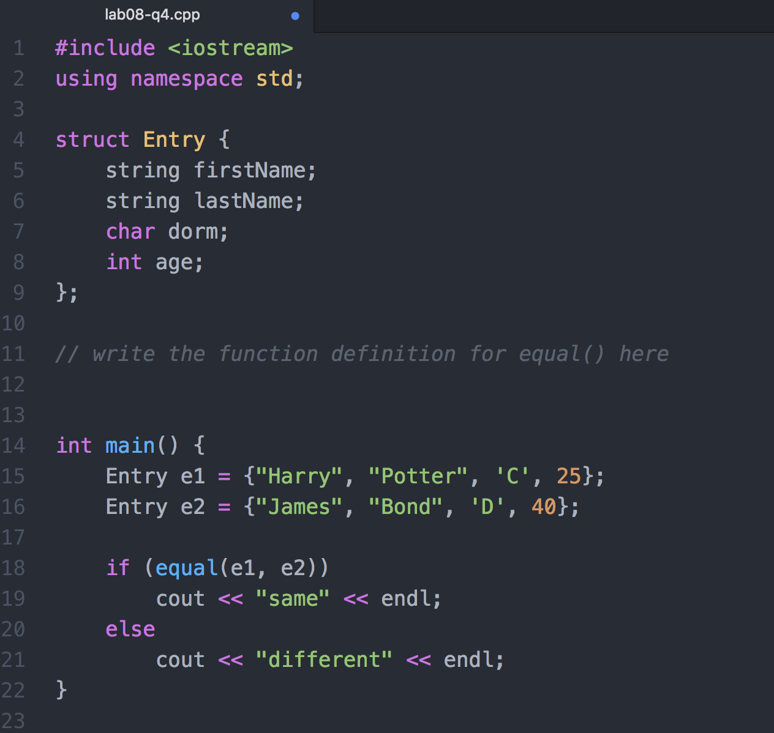
Problem 2
Fill in the body of the equal function below. The function will return true if the member variables of the structure contain the same data and false otherwise.
<number>

Slide 29
More examples on struct and function
struct Circle {
double x, y;
double r;
};
Consider struct Circle, and we are to implement the following three functions:
Function 1: To compute the area of a circle
Function 2: To enlarge a circle (i.e., increase its radius)
Function 3: To check whether a circle overlaps with another circle
What would possibly be the function prototypes for the above functions?
Think about the input and output of these functions.
<number>

Slide 30
More examples on struct and function
Function prototypes
Function 1: To compute the area of a circle
Input: a circle, output: the area
Function 2: To enlarge a circle (i.e., increase its radius)
Input: a circle, the increment in radius; the circle radius needs to be modified
Function 3: To check whether a circle overlaps with another circle
Input: two circles, output: whether they overlaps
double CircleArea(Circle c);
void EnlargeCircle(Circle &c, double radius_to_add);
bool IsCircleOverlap(Circle c1, Circle c2);
<number>

Slide 31
More examples on struct and function
struct Circle {
double x, y;
double r;
};
Implementation of the three functions
Function 1: To compute the area of a circle
double CircleArea(Circle c) {
const double PI = 3.14159265358979323846;
return PI * c.r * c.r;
}
circle.cpp
<number>

Slide 32
More examples on struct and function
struct Circle {
double x, y;
double r;
};
Implementation of the three functions
Function 2: To enlarge a circle (i.e., increase its radius)
void EnlargeCircle(Circle &c, double radius_to_add) {
c.r += radius_to_add;
}
circle.cpp
<number>

Slide 33
More examples on struct and function
struct Circle {
double x, y;
double r;
};
Implementation of the three functions
Function 3: To check whether a circle overlaps with another circle
bool IsCircleOverlap(Circle c1, Circle c2) {
double dx = c1.x - c2.x;
double dy = c1.y - c2.y;
double centre_dist = sqrt(dx*dx + dy*dy);
return (centre_dist <= (c1.r + c2.r));
}
circle.cpp
Now, we have implemented a structure Circle and also three functions that operates on the structure. As mentioned, the structure with member variables only and all three functions are valid in both C and C++.
<number>

Slide 34
More examples on struct and function
Example use of the three functions
int main() {
Circle p = {1,1,2}, q = {2,2,1};
EnlargeCircle(p, 5);
cout << "new radius of p: " << p.r << endl;
cout << "area of q: " << CircleArea(q) << endl;
cout << "p and q overlap? " << (IsCircleOverlap(p, q) ? "Yes" : "No") << endl;
return 0;
}
circle.cpp
<number>

Slide 35
Structs with member variables only
The example structs which we can come across so far contain member variables only:
In C, a struct can only contain member variable.
In C++, you may also define member functions for struct.
struct Student {
int id;
string name;
char sex;
double GPA;
};
struct Product {
int productID;
double price;
};
struct Point {
double x;
double y;
};
struct Circle {
double x, y;
double r;
};
So these structure definitions are valid in both C and C++.
<number>

Slide 36
Structs with Member Functions
Let’s take a look at how we can implement member functions for structure in C++.
Again consider the structure Circle:
We can implement a member function for the structure to compute the area of the circle.
struct Circle {
double x, y;
double r;
};
<number>

Slide 37
Structs with Member Functions
struct Circle {
double x, y;
double r;
double Area() {
const double PI = 3.14159265358979323846;
return PI * r * r;
}
};
circle_structfunc.cpp
Note how we may define a function within a struct body.
The member function can access the member variable of the structure.
Therefore, the function Area() does not need to take any input, and it can use the member variable r directly to compute the area.
Compare this to the implementation of Function 1.
<number>

Slide 38
Structs with Member Functions
We may also write only the function prototype inside the struct and move the function definition move outside of the struct:
struct Circle {
double x, y;
double r;
double Area();
};
double Circle::Area()
{
const double PI = 3.14159265358979323846;
return PI * r * r;
}
The scope resolution operator "::" indicates that this function Area() belongs to the structure Circle
circle_structfunc.cpp
<number>

Slide 39
Structs with Member Functions
To implement Function 2 as a member function of Circle:
struct Circle {
double x, y;
double r;
double Area();
void EnlargeCircle(double radius_to_add) {
r += radius_to_add;
};
}
double Circle::Area()
{
const double PI = 3.14159265358979323846;
return PI * r * r;
}
We’ll just leave this member function here inside the struct body, without moving it out
Update r directly
circle_structfunc.cpp
<number>

Slide 40
Structs with Member Functions
To implement Function 3 as a member function of Circle:
struct Circle {
double x, y;
double r;
double Area();
void EnlargeCircle(double radius_to_add) {
r += radius_to_add;
};
bool IsOverlap(Circle c);
};
bool Circle::IsOverlap(Circle c) {
double dx = x - c.x;
double dy = y - c.y;
double centre_dist = sqrt(dx*dx + dy*dy);
return (centre_dist <= (r + c.r));
}
Check if this circle (i.e., the circle whose member function is called) overlaps with the input circle c
circle_structfunc.cpp
<number>

Slide 41
Structs with Member Functions
Example use of the three member functions
int main() {
Circle p = {1,1,2}, q = {2,2,1};
p.EnlargeCircle(5);
cout << "new radius of p: " << p.r << endl;
cout << "area of q: " << q.Area() << endl;
cout << "p and q overlap? " << (p.IsOverlap(q) ? "Yes" : "No") << endl;
return 0;
}
Again we use the dot operator . to access the member functions of a structure
circle_structfunc.cpp
<number>

Slide 42
Important: This topic on “Classes” are optional but highly recommended. Students are not required to write code to implement a class at this stage, but it would be helpful if you can understand codes for class implementation.
Classes
<number>

Slide 43
Optional but Recommended
Abstract Data Types
Sometimes we would like a certain data type to be associated with specific operations.
Integers: +, −, *, /
Points: translate, distance
Strings: length, substring, replace
An abstract data type (ADT) encapsulates both the data and the methods (i.e., operations) of into a package, so that users are restricted to perform only certain operations against the data inside. Also, the implementation details (how the data is stored, how the operations are carried out) of an ADT is hidden from the user (aka encapsulation or information hiding).
<number>

Slide 44
Optional but Recommended
Abstract Data Types
When you want to use an ADT to solve a problem, we only care about what can be done with them (i.e., the operations / interface ), but not how they are done (i.e., the implementation).
string s = "I am mysterious";
cout << s.length() << endl;
cout << s.substr(0, 5) << endl;
cout << s.find("am") << endl;
When you use a string object, do you need to know how the string is stored internally, and how a substring is extracted by the .substr() function?
As a user for the string class, we only care about what operations are available.
This is like when we use a function, we only need to know what it does by looking at its prototype, e.g., double sqrt( double x); but we don't care about how it comes up with the result.
<number>

Slide 45
Optional but Recommended
Abstract Data Types
Compare with this: When we use struct Point, we need to know how the coordinates are stored if we need to write a function to do anything on them.
struct Point {
double x;
double y;
};
// distance between two points p and q
double point_distance( Point p, Point q ) {
double dx = p.x – q.x;
double dy = p.y – q.y;
return sqrt( dx * dx + dy * dy );
}
What if we later change our mind and want to use an array of 2 doubles instead to store x and y? Then any function making use of Point (e.g., point_distance()) will need to be modified.
struct Point {
double v[2];
};
Hence, it would be great if an ADT can provide “interfaces” for accessing its data, so other developers who want to use the ADT do not need to care about the internal representation/implementation (i.e., even if these changes, one doesn’t need to change his code that uses the ADT).
<number>

Slide 46
Optional but Recommended
Classes
ADTs are implemented using classes in C++. A class contains data (member variables) and methods (member functions) and is divided into two sections.
Public Section
Data/methods here are accessible by the application program/code using an object of this class.
Abstraction of the ADT
member functions
class Point {
public:
double getX();
double getY();
double distance(Point & p);
void translate(Point & p);
private:
double x;
double y;
};
The public and private sections may contain both member variables and functions. However, we should avoid defining member variables in the public section in order to enforce access of ADT internal data via member functions. Hence the member functions serve as the “interfaces” which we mentioned earlier. You will learn more about class design in the Object Oriented Programming (OOP) course.
Private Section
Data/methods here can only be accessible by the member functions of the same class.
Implementation of the ADT
member variables
<number>
For C++ struct, member variables and functions are by default, while they are by default private for class.

Slide 47
Optional but Recommended
Class Definitions
A member function can access the private variable of the class. Since it is defined under the public section, others can have “access” to the private variables via this function.
Keyword for defining a class
class Point {
public:
double getX() { return x; }
double getY() { return y; }
void setCoord(double s, double t) {
x = s;
y = t;
}
double distance(Point & p);
void translate(Point & p);
private:
double x;
double y;
};
Member function definitions
Access specifier
Member function prototypes. Note that these functions are not defined yet (i.e., we need to define them somewhere else).
As designer of a class, you may choose whether to include the definition or just the prototype for a member function inside a class definition. There are some design considerations, but we won’t go in the details here (again we’ll leave it to the OOP course).
Member variable declarations
Ends with a ;
<number>

Slide 48
Optional but Recommended
Member Functions
Member functions can be defined outside the class body:
The function distance() is a member function of Point. Suppose we have a variable (object), say “q”, of type Point. Then the distance() function of “q” can access the x, y coordinates of “q”. Here, “this point” means the point “q”.
The scope resolution operator "::" indicates variable/function membership of a class
Recall – std::endl
// distance between this point and point p
double Point::distance(Point & p) {
double dx = p.x – x;
double dy = p.y – y;
return sqrt( dx * dx + dy * dy);
}
// translate this point by an offset p
void Point::translate(Point & p) {
x += p.x;
y += p.y;
}
Member variable "x" of the input Point "p"
Member variable "x" of "this" Point
<number>

Slide 49
Optional but Recommended
Class Declaration
To declare an object (variable) for a class:
Each object can then retain their own values for each member variables
Class_name object_name1, object_name2, …;
Point p1, p2;
string s1("abc");
Since class are just user-defined data types, you can declare just like how you declare an int, a double, etc.
Examples:
"p1", "p2" are Point objects, "s1" is a string object (YES, string is just a class)
p1
p2
p1.setCoord(1, 2);
p2.setCoord(4, 5);
Examples:
x
1
x
4
y
2
y
5
<number>

Slide 50
Optional but Recommended
Multiple Files Compilation for Class Implementation
It is a common practice to put the codes for a class in a separate file, so that the class can be reused by another file or program.
We also further separate the definition and implementation of a class in .h and .cpp files, respectively. Doing so allows users of a class to focus only on the class interface (which defines how to use the class) in the header file (.h)
#include "point.h"
int main()
{
Point p, q;
…
p.distance(q);
…
return 0;
}
class Point
{
public:
…
private:
…
};
double Point::distance(Point & p) {
…
}
void Point::translate(Point & p)
{
…
}
main.cpp
point.h
point.cpp
Main program
Class interface
Class implementation
Any other program that wants to use Point can just include "point.h".
Check the sample programs and also the Makefile for this example.
<number>

Slide 51
Part II
FILE I/O
<number>

Slide 52
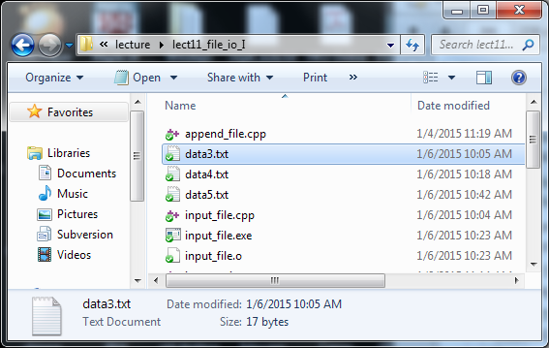
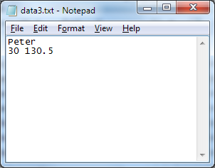
File Input/Output
Files are used for storing data permanently. The data is stored in the hard drive of your computer and you can read and write from it with your program.
C++ simply views a file as a sequence of bytes:
Contents of "data3.txt"
'P' | 'e' | 't' | 'e' | 'r' | '\n' | '3' | '0' | ' ' | '1' | '3' | '0' | '.' | '5' | eof
A file in the file system named "data3.txt"
end of file marker
<number>

Slide 53
Streams
C++ uses a convenient abstraction called streams to perform input and output operations in sequential media, e.g.,
cout is a stream object for sending output to the screen
cin is a stream object for taking input from keyboard
C++ provides two classes, namely ofstream and ifstream, for writing and reading data to and from files
To use the classes ofstream and ifstream, simply include the header file fstream, i.e.,
#include <fstream>
<number>

Slide 54
Write to File
<number>

Slide 55
Output File Stream
A basic example for creating and writing to a file
string name = "Peter";
int age = 30;
double weight = 130.5;
fout << name << " " << age << " "
<< weight << endl;
fout.close();
return 0;
}
#include <iostream>
#include <fstream>
#include <cstdlib>
#include <string>
using namespace std;
int main()
{
ofstream fout;
fout.open("data1.txt");
if ( fout.fail() ) {
cout << "Error in file opening!" << endl;
exit(1);
}
Include the file stream header file
Create an ofstream (output file stream) object and connect it to an external file named "data1.txt"
These two statements can be replaced by:
ofstream fout ("data1.txt");
After executing these two statements, a file will be created in your hard drive (in the same directory as your program executable):
data1.txt
output_file.cpp
<number>

Slide 56
Output File Stream
A basic example for creating and writing to a file
string name = "Peter";
int age = 30;
double weight = 130.5;
fout << name << " " << age << " "
<< weight << endl;
fout.close();
return 0;
}
#include <iostream>
#include <fstream>
#include <cstdlib>
#include <string>
using namespace std;
int main()
{
ofstream fout;
fout.open("data1.txt");
if ( fout.fail() ) {
cout << "Error in file opening!" << endl;
exit(1);
}
This if block serves to exit the program if unable to create file.
Function exit forces a program to terminate immediately, and is often used to terminate a program when an error is detected in the input or if a file to be processed by the program cannot be opened.
data1.txt
output_file.cpp
<number>

Slide 57
Output File Stream
A basic example for creating and writing to a file
string name = "Peter";
int age = 30;
double weight = 130.5;
fout << name << " " << age << " "
<< weight << endl;
fout.close();
return 0;
}
#include <iostream>
#include <fstream>
#include <cstdlib>
#include <string>
using namespace std;
int main()
{
ofstream fout;
fout.open("data1.txt");
if ( fout.fail() ) {
cout << "Error in file opening!" << endl;
exit(1);
}
Write to the file stream fout using the insertion operator << (just as what we do with cout)
Finally disconnects the file stream fout from the external file
data1.txt
Peter 30 130.5\n
eof
output_file.cpp
<number>

Slide 58
Summary Steps for Creating and Writing to a File
ofstream fout;
Declare an output stream variable.
Open the file
Check if there is any error in opening the file
Use the insertion operator << to write to file
Close the file
fout.open("data.txt");
if (fout.fail())
fout << "12345";
fout.close();
string filename = "data.txt";
fout.open(filename.c_str());
if the file name is stored as string
<number>

Slide 59
Appending Data to a File
When opening a file for output using the member function open(), a new file will be created if the file does not already exist, otherwise the content of the existing file will be erased
To keep the content of the existing file and append new data to it, supply the constant value ios::app as a second argument to the member function open(), e.g.,
fout.open("data2.txt", ios::app)
<number>

Slide 60
Appending Data to a File
string name = "John";
int age = 25;
double weight = 129.3;
fout << name << " " << age << " "
<< weight << endl;
fout.close();
return 0;
}
#include <iostream>
#include <fstream>
#include <cstdlib>
#include <string>
using namespace std;
int main()
{
ofstream fout;
fout.open("data2.txt", ios::app);
if (fout.fail()) {
cout << "Error in file opening!"
<< endl;
exit(1);
}
data2.txt (before executing the program)
Peter 30 130.5\n
eof
data2.txt (after executing the program)
Peter 30 130.5\n
John 25 129.3\n
eof
append_file.cpp
<number>

Slide 61
Read from File
<number>

Slide 62
Input File Stream
A basic example for reading from an existing file
string name;
int age;
double weight;
fin >> name >> age >> weight;
fin.close();
cout << name << ", " << age << ", "
<< weight << endl;
return 0;
}
#include <iostream>
#include <fstream>
#include <cstdlib>
#include <string>
using namespace std;
int main()
{
char filename[80] = "data3.txt";
ifstream fin;
fin.open(filename);
if ( fin.fail() ){
cout << "Error in file opening!"
<< endl;
exit(1);
}
Include the file stream header file
Create an ifstream (input file stream) object and connect it to an external file named "data3.txt"
These few statements can be replaced by:
ifstream fin ("data3.txt");
Since the open() function accepts only a C-string as the input parameter, if the file name is stored in a string class, we will need to write:
string filename = "data3.txt"
ifstream fin( filename.c_str() );
data3.txt
Peter\n
30 130.5\n
eof
input_file.cpp
<number>

Slide 63
Input File Stream
A basic example for reading from an existing file
string name;
int age;
double weight;
fin >> name >> age >> weight;
fin.close();
cout << name << ", " << age << ", "
<< weight << endl;
return 0;
}
#include <iostream>
#include <fstream>
#include <cstdlib>
#include <string>
using namespace std;
int main()
{
char filename[80] = "data3.txt";
ifstream fin;
fin.open(filename);
if ( fin.fail() ){
cout << "Error in file opening!"
<< endl;
exit(1);
}
Exit the program if the file does not exist
data3.txt
Peter\n
30 130.5\n
eof
input_file.cpp
<number>

Slide 64
Input File Stream
A basic example for reading from an existing file
string name;
int age;
double weight;
fin >> name >> age >> weight;
fin.close();
cout << name << ", " << age << ", "
<< weight << endl;
return 0;
}
#include <iostream>
#include <fstream>
#include <cstdlib>
#include <string>
using namespace std;
int main()
{
char filename[80] = "data3.txt";
ifstream fin;
fin.open(filename);
if ( fin.fail() ){
cout << "Error in file opening!"
<< endl;
exit(1);
}
Read from the file stream fin using the extraction operator >> (just as what we do with cin)
Finally disconnects the file stream fin from the external file
data3.txt
Peter\n
30 130.5\n
eof
Screen output
Peter, 30, 130.5
input_file.cpp
<number>

Slide 65
Summary Steps for Reading Input from a File
ifstream fin;
Declare an ifstream object.
Open the file
Check if there is any error in opening the file
Read data from file using the extraction operator >>
Close the file
fin.open("data.txt");
if (fin.fail())
fin >> x;
fin.close();
<number>

Slide 66
Reading until End of File (EOF)
Very often, data have to be extracted sequentially from an input file until the end of file (eof) has been reached (because we don't know the length of a file in advance)
This can be done by using a while loop as follows:
The return value of the expression fin >> x:
A nonzero (true) value indicates a datum has been read successfully
A zero (false) value indicates the eof has been reached and no datum has been read
while (fin >> x)
{
…
}
<number>

Slide 67
Reading until End of File (EOF)
Example
double x, sum = 0;
while (fin >> x) {
sum += x;
}
fin.close();
cout << "Total = " << sum
<< endl;
return 0;
}
#include <iostream>
#include <fstream>
#include <cstdlib>
#include <string>
using namespace std;
int main()
{
ifstream fin;
fin.open("data4.txt");
if (fin.fail()) {
cout << "Error in file opening!"
<< endl;
exit(1);
}
Read and sum until end of file
data4.txt
20.0 40.0 60.0 eof
Screen output
Total = 120
read_till_eof.cpp
<number>

Slide 68
Reading Lines From a File
Sometimes, data in a file may need to be processed in a line by line manner, e.g., each line stores the record of one person
The library function getline() can be used to read in a line from an input file stream object and store it as a string object, e.g.,
Similarly, the return value of getline() can be used to check if the eof has been reached
A nonzero (true) value indicates a line has been read successfully
A zero (false) value indicates the eof has been reached and no line has been read
getline(fin, str);
fin is an input file stream object and str is a string object (both are call-by-reference parameters)
<number>

Slide 69
Reading Lines From a File
Example:
string line;
while ( getline(fin, line) ) {
cout << line << endl;
}
fin.close();
return 0;
}
#include <iostream>
#include <fstream>
#include <cstdlib>
#include <string>
using namespace std;
int main()
{
ifstream fin;
fin.open("data5.txt");
if (fin.fail()) {
cout << "Error in file opening!"
<< endl;
exit(1);
}
data5.txt
Peter 30 130.5\n
John 129.3\n
eof
Screen output
Peter 30 130.5
John 129.3
read_line_file.cpp
<number>

Slide 70
Problem 3
Write a program copyfile.cpp that prompts the user for a file name of a text file, reads the file and writes its content to a new file. This essentially copies an existing file to another file.
<number>

Slide 71
Input String Stream
While C++ considers file as a stream of characters, it can also take strings as a stream of characters too. The class istringstream is provided for extracting data from a string. To use this class, simply include the header file <sstream>, i.e.,
An input string stream object can be declared using the class name istringstream and initialized with a string object as follows
Data can then be extracted from the input string stream using the extraction operator >>
#include <sstream>
string str;
istringstream iss(str);
int age;
iss >> age;
<number>

Slide 72
Input String Stream
Similarly, data can be extracted sequentially from the stream until the end of string has been reached by checking the return value of the expression
A nonzero (true) value indicates a datum has been read successfully
A zero (false) value indicates the end of string has been reached and no datum has been read
input_string_stream >> variable
<number>

Slide 73
Input String Stream
Example
#include <iostream>
#include <sstream>
#include <string>
using namespace std;
int main()
{
string line=" apple orange banana ", word;
istringstream line_in(line);
while ( line_in >> word ) {
cout << "\"" << word << "\""
<< endl;
}
return 0;
}
Screen output
"apple"
"orange"
"banana"
input_string_stream.cpp
<number>

Slide 74
Stream Output Formatting
Sometimes you may want to have the output from your program to be displayed (on screen) or stored (in file) in a specific format
Floating-point numbers: 0.00001 or 1e-5? 15 or 15.000?
Formatted tabular output:
We may use the output manipulators to format the output. We've come across some examples:
endl, to move the insertion point to the beginning of the next line
setw, to set the width of the column for the next output value
Peter 30 130.5
John 6 129.3
Mary 18 34.5
How to set the width of each column?
How to set the column alignment?
<number>

Slide 75
Default floating-point notation
Example
Default to 6 significant digits
#include <iostream>
using namespace std;
int main()
{
double a = 1.2345678;
double b = 0.00012345678;
double c = 1234567.8;
double d = 0.000012345678;
cout << a << endl << b << endl << c << endl << d << endl;
return 0;
}
Screen output
1.23457
0.000123457
1.23456e+06
1.23457e-05
Lengthy numbers are written in scientific notation
default_float.cpp
<number>

Slide 76
showpoint Manipulator
Example
default is no decimal point if decimal value is 0
#include <iostream>
using namespace std;
int main()
{
double e = 12.0;
cout << e << endl;
cout << showpoint << e << endl;
return 0;
}
Screen output
12
12.0000
display decimal point with padding zeros with showpoint
can be unset with the noshowpoint manipulator
default_float.cpp
<number>

Slide 77
fixed / scientific Manipulators
fixed to write floating-point numbers as fixed decimal
scientific to output floating-point numbers in scientific notation
#include <iostream>
using namespace std;
int main()
{
double f = 0.135;
cout << f << endl;
cout << fixed << f << endl;
cout << scientific << f << endl;
cout.unsetf(ios_base::floatfield);
cout << f << endl;
return 0;
}
Screen output
default
0.135
0.135000
fixed
1.350000e-01
0.135
Scientific notation
default
manipulator_fixed.cpp
<number>

Slide 78
setprecision Manipulator
With the default floating-point notation, setprecision specifies the maximum number of meaningful digits before and after the decimal point.
#include <iostream>
#include <iomanip>
using namespace std;
int main()
{
double a = 1.2345678;
double b = 1234567.8;
cout << a << '\n' << b << "\n\n";
cout << setprecision(2);
cout << a << '\n' << b << '\n';
return 0;
}
Screen output
1.23457
1.23457e+006
1.2
1.2e+006
showing 2 significant digits with setprecision(2)
manipulator_setprecision.cpp
<number>

Slide 79
setprecision Manipulator
With the fixed or scientific notation, setprecision specifies the exact number of digits after the decimal point. By default, 6 decimal places are used.
#include <iostream>
#include <iomanip>
using namespace std;
int main()
{
double a = 1.2345678;
double b = 1234567.8;
cout << fixed << setprecision(2);
cout << a << '\n' << b << "\n\n";
cout << setprecision(8);
cout << a << '\n' << b << '\n';
return 0;
}
Screen output
showing 2 decimal places with setprecision(2)
1.23
1234567.80
1.23456780
1234567.80000000
Showing 8 decimal places with padding zeros at the end with setprecision(8)
Try using setprecision with scientific notation
manipulator_setprecision.cpp
<number>

Slide 80
setw Manipulator
Use setw to output a string or a number in a specific number of columns (the output is right-justified).
#include <iostream>
#include <iomanip>
using namespace std;
int main()
{
int x = 12; string a = "Hello";
double b = 34.567;
cout << fixed << setprecision(2); cout << "12345678901234567890\n";
cout << setw(5) << x << setw(8) << a;
cout << setw(6) << b << endl;
return 0;
}
Screen output
12345678901234567890
12 Hello 34.57
5 cols
8 cols
6 cols
For those manipulators that accept parameters such as setw(x), include the <iomanip> header; otherwise for those manipulator without parameters such as fixed, include the <iostream> header
manipulator_setw.cpp
<number>

Slide 81
setfill Manipulator
With setw, if the specified number of columns > the required number of columns, the unused columns are filled with spaces. We may use setfill to fill the unused columns with other characters.
#include <iostream>
#include <iomanip>
using namespace std;
int main()
{
int x = 12;
string a = "Hello";
double b = 34.567;
cout << fixed << setprecision(2);
cout << "12345678901234567890\n";
cout << setfill('*');
cout << setw(5) << x << setw(8) << a;
cout << setw(6) << b << endl;
return 0;
}
Screen output
12345678901234567890
***12***Hello*34.57
manipulator_setw.cpp
<number>

Slide 82
left / right Manipulators
With setw, the default output is right-justified within a column. Use the left and right manipulators to set the output to be left-justified or right-justified, respectively.
…
cout << "12345678901234567890\n"; cout << setfill('-');
cout << left;
cout << setw(5) << x << setw(8) << a;
cout << setw(6) << b << endl;
cout << right;
cout << setw(5) << x << setw(8) << a;
cout << setw(6) << b << endl;
…
Screen output
12345678901234567890
12---Hello---34.57-
---12---Hello-34.57
left and right are defined in <iostream>
manipulator_setw.cpp
<number>

Slide 83
Further References on File I/O
C++ Language Tutorial: Input/Output with files http://www.cplusplus.com/doc/tutorial/files/
C++ Library Reference: ifstream class http://www.cplusplus.com/reference/fstream/ifstream/
C++ Library Reference: istringstream class http://www.cplusplus.com/reference/sstream/istringstream/
C++ Library Reference: ofstream class http://www.cplusplus.com/reference/fstream/ofstream/
C++ Library Reference: ofstream class http://www.cplusplus.com/reference/library/manipulators/
<number>

Slide 84
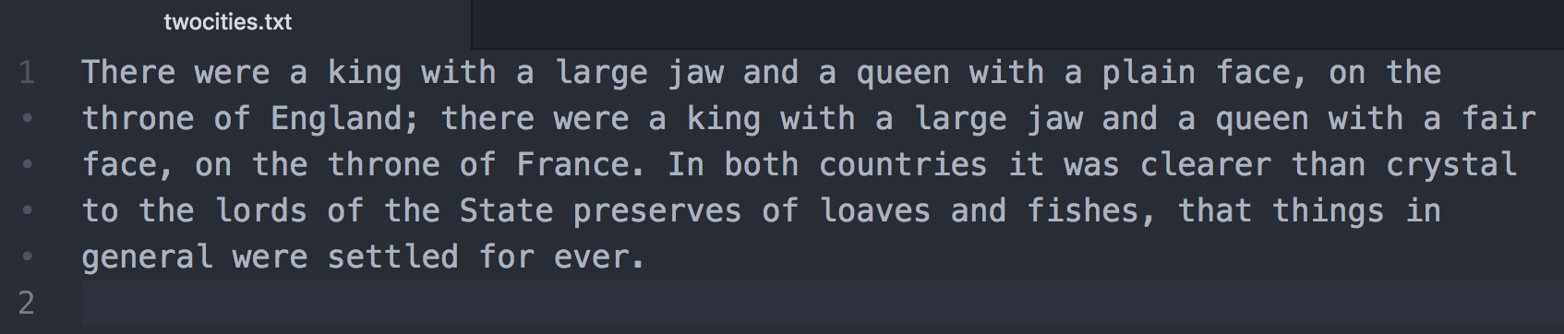
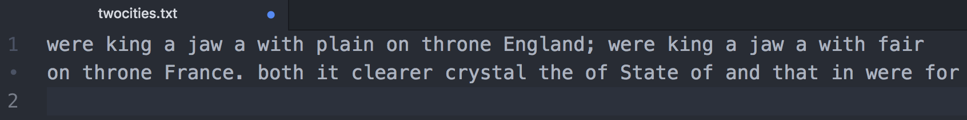
Problem 4
Create a text ﬁle and save it on your computer. Here is an example.
Write a C++ program that reads in the content of the ﬁle and then outputs only every second word on the screen. Your program should output the following for the given text ﬁle.
<number>

Slide 85
Problem 5
Write a program that will search a ﬁle of numbers of type int and write the largest and the smallest numbers to the end of that ﬁle. The ﬁle contains nothing but numbers of type int separated by spaces or line breaks.
<number>

Slide 86
Problem 6
Write a program that will read in a ﬁle containing nothing but numbers of type int separated by spaces or line breaks. Sort the numbers and write them into a new ﬁle.
<number>

Slide 87
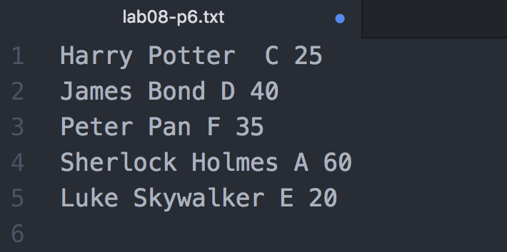
Problem 7
Read a text file that consists of a list of Entry.(see Problem 2). Here is an example:
Save the entries as an array of type Entry. Sort the list by age and output the result on the screen. You may assume that there are at most 100 entries in the text file.
<number>

Slide 88
Part III
Recursion
<number>

Slide 89
What are we going to learn?
Recursive definition
Recursive functions in C++
Flow of control in recursive functions
General structure of a recursive function
Examples of recursive functions
Stack overflow problem
Recursion versus iteration
<number>

Slide 90
Recursive Definition
Some problems are recursive by nature, i.e., it has a recursive definition which means that the problem can be defined in terms of a smaller version of itself.
Consider the factorial of a nonnegative integer:
Definition 1
0! = 1
n! = n × (n−1) × (n−2) × … × 2 × 1, if n > 0
An iterative definition
Definition 2
0! = 1
n! = n × (n−1)!, if n > 0
A recursive definition
<number>

Slide 91
Recursive Definition
How does a recursive definition work?
Base case
Eq. (1):
Eq. (2):
0! = 1
n! = n × (n−1)!, if n > 0
General case
To calculate 3! :
1. Apply Eq. (2) :
3! = 3 × 2!
General case
7. Substitute: 3! = 3 × 2 = 6
2. Apply Eq. (2) :
2! = 2 × 1!
General case
6. Substitute: 2! = 2 × 1 = 2
3. Apply Eq. (2) :
1! = 1 × 0!
General case
5. Substitute: 1! = 1 × 1 = 1
4. Apply Eq. (1) :
0! = 1
Base case
<number>

Slide 92
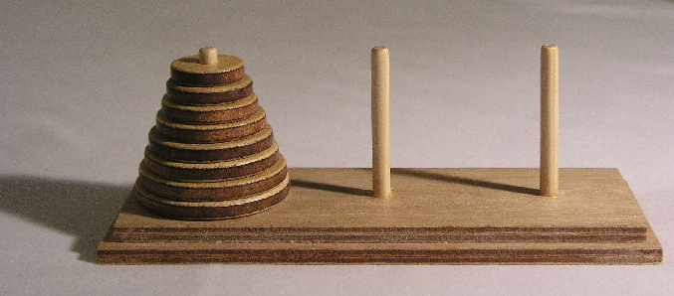
Recursive Definition
Properties for a recursive definition
Must have one (or more) base cases
The general case must be reduced to a base case eventually
The base case terminates the recursion
Some more examples of recursive problems
Fibonacci sequence: 0, 1, 1, 2, 3, 5, 8, 13, 21, 34, …
F_{n} = F_{n-1} + F_{n-2} , F₀ = 0, F₁ = 1
Tower of Hanoi
General case: a number is the sum of its previous two numbers
Image from Wikimedia Commons
<number>

Slide 93
Recursive Function
In C/C++, we may write recursive function to implement recursion.
A recursive function is one that contains a call to itself.
int factorial(int num)
{
if (num == 0)
return 1;
else
return num * factorial(num – 1);
}
Base case
General case
Since the argument passed to the functions keeps decrementing by 1, we are certain that the base case will be reached eventually which stops the recursion.
factorial.cpp
<number>

Slide 94
Flow of Control
Flow of control is essentially the same as function calls, except that the same function is repeatedly called.
Suppose we call factorial(3):
int factorial(int num)
{
if (num == 0)
return 1;
else
return num * factorial(num – 1);
}
factorial(3)
factorial(3) = 6
num
3
Halts at return 3 * factorial(2);
return 3 * 2
num
2
factorial(2) = 2
factorial(2)
Halts at return 2 * factorial(1);
return 2 * 1
num
1
factorial(1) = 1
factorial(1)
Halts at return 1 * factorial(0);
return 1 * 1
factorial(0)
num
0
factorial(0) = 1
Executes return 1;
return 1
<number>

Slide 95
General Structure
The process of calling a function itself recursively can be repeated any number of times.
How to avoid infinite recursion?
General structure for a recursive function definition:
Having one or more recursive calls to itself to accomplish smaller tasks
Having one or more base cases without using recursive calls to terminate the recursion
int factorial(int num)
{
if (num == 0)
return 1;
else
return num * factorial(num – 1);
}
Base case without using recursion
Recursion to handle smaller tasks by making recursive calls
<number>

Slide 96
Example: Fibonacci Sequence
Recursive definition for the problem:
F₀ = 0, F₁ = 1
F_{n} = F_{n-1} + F_{n-2} , if n > 1
Base case
The sequence:
0, 1, 1, 2, 3, 5, 8, 13, 21, 34, …
Recursion
int fib(int num)
{
}
Base case without using recursion
if (num < 2)
return ???;
num;
else
return ???;
fib(num-1) + fib(num-2);
fibonacci.cpp
Recursion to handle smaller tasks by making recursive calls
<number>

Slide 97
Example: Fibonacci Sequence
Suppose we call
fib(4):
fib(4)
return 3
Hence, fib(4) = 3
num
4
17
return fib(3) + fib(2)
1
return 2
11
return 1
fib(3)
10
fib(2)
16
num
3
num
2
return fib(2) + fib(1)
return fib(1) + fib(0)
2
7
8
9
12
return 1
14
return 0
return 1
return 1
fib(1)
13
fib(0)
fib(2)
fib(1)
15
num
2
num
1
num
1
num
0
return fib(1) + fib(0)
return num
return num
return num
3
return 1
5
return 0
fib(1)
4
fib(0)
6
num
1
num
0
return num
return num
<number>

Slide 98
Example: Greatest Common Divisor
Euclidean algorithm
E.g., gcd of 48 and 18:
2
1
2
18
48
36
12
18
12
6
12
12
gcd = 6
12
18÷12
6
12÷6
0
A recursive definition
int gcd(int x, int y)
{
}
gcd(x, y)
x, if y = 0
if (y == 0)
return ???;
=
x;
gcd( y, remainder of x / y ) ,
otherwise
else
return ???;
gcd(y, x%y);
gcd.cpp
<number>

Slide 99
Example: Palindrome
Recall that a palindrome is a word that reads the same forward and backward, e.g., level, noon, racecar
Recursive algorithm
r | a | c | e | c | a | r
To check if a string s[0..n–1] is a palindrome,
if n < 2, s is a palindrome
otherwise, s is a palindrome if and only if s[0] is the same as s[n-1] and s[1..n-2] is a palindrome
bool is_palindrome( string s )
{
}
if (s.length() < 2)
return ???;
true;
else
return ???;
(s[0] == s[s.length()-1])
&& is_palindrome(s.substr(1,s.length()-2));
<number>
palindrome_recursive.cpp

Slide 100
Example: Tower of Hanoi
The Tower of Hanoi is a mathematical game, consisting of three rods and disks of different sizes which can slide onto any rod.
The puzzle starts with the disks neatly stacked in order of size on one rod, the smallest at the top, thus making a conical shape.
Objectives: To move the entire stack to another rod.
Rules:
Only one disk may be moved at a time
The removed disk must be placed on one of the rods
No disk may be placed on top of a smaller disk
<number>
Image from Wikimedia Commons

Slide 101
Tower of Hanoi
Suppose the task is to move the stack from rod A to rod C
What if the initial stack contains 1 disk only?
Move from A to C
A
B
C
A
B
C
Done! 1 step
What if the initial stack contains 2 disks?
Move from A to B
A
B
C
A
B
C
Move from A to C
A
B
C
Move from B to C
A
B
C
Done! 3 steps
<number>

Slide 102
Example: Tower of Hanoi
What if the initial stack contains 3 disks?
1
Move from A to C
A
B
C
A
B
C
2
Move from A to B
A
B
C
3
Move from C to B
A
B
C
4
Move from A to C
A
B
C
<number>
Notes:
<number>

Slide 103
Example: Tower of Hanoi
5
Move from B to A
A
B
C
A
B
C
6
Move from B to C
A
B
C
7
Move from A to C
A
B
C
Done! 7 steps
What if the initial stack contains 64 disks???
Look at the example for moving 3 disks:
Steps 1 to 3 essentially move a stack of 2 disks from A to B
Step 4 moves a disk (the lowest of the initial stack) from A to C
Steps 5 to 7 essentially move a stack of 2 disks from B to C
A recursive algorithm!
<number>
Notes:
<number>

Slide 104
Example: Tower of Hanoi
Recursive algorithm
To move a stack of n disks from rod A to rod C, n >= 1
Move the top n – 1 disks from A to B, using C as an intermediate rod
Move the remaining 1 disk from A to C
Move the top n – 1 disks from B to C, using A as an intermediate rod
No. of disks to move
Source rod
Destination rod
Intermediate rod
void move(int n, char src, char des, char tmp)
{
}
if (n == 1)
cout << "Move disk from " << src << " to " << des << endl;
else {
}
move( n-1, src, tmp, des);
move( 1, src, des, tmp);
move( n-1, tmp, des, src);
hanoi.cpp
<number>

Slide 105
Example: Tower of Hanoi
How many steps does it take to move 64 disks?
Hence, it takes
2⁶⁴- 1 ≈ 1.6 × 10¹⁹ steps to move 64 disks
No. of steps to move n disks
T(n) = 2 T(n – 1) + 1
If it takes 1 second to move a disk physically by hand, it would take 5 × 10¹¹ years to finish.
= 2 [ 2 T(n – 2) + 1 ] + 1
= 2² T(n – 2) + 2 + 1
= 2² [ 2 T(n – 3) + 1 ] + 2 + 1
= 2³ T(n – 3) + 2² + 2 + 1
= …
= 2^{n – 1} T(n – (n – 1)) + 2^{n – 2} + … + 2² + 2 + 1
= 2^{n – 1} T(1) + 2^{n – 2} + … + 2² + 2 + 1
= 2^{n – 1} + 2^{n – 1} + … + 2² + 2 + 1
= 2^{n} – 1
If a computer can generate 10⁹ moves per second, it still takes 500 years to generate all the moves!
<number>

Slide 106
Stack Overflow
Each function call entails additional memory space (function call stack).
There is always some limit to the memory size.
If there is excessively long chain of recursive call, e.g., infinite recursion, stack overflow error may occur
Try the Tower of Hanoi program and see what’s the largest n that will crash your machine ☺
<number>

Slide 107
Recursion vs Iteration
Recursion is NOT absolutely necessary.
Any task that can be accomplished using recursion can also be done in some other way without using recursion.
The non-recursive version of a function typically uses a loop of some sort in place of recursion, hence often being referred to as iterative version.
A recursively written function will usually run slower and use more storage than an equivalent iterative version (due to extra work in memory management for function calls (aka stack management).
Nonetheless, using recursion can sometimes make the job of programming easier and produce code that is easier to understand.
<number>

Slide 108
Recursion vs Iteration
Recursive example:
Iterative example:
int binary_search(int A[], int lb, int ub, int value)
{
if (lb > ub)
return -1;
else
{
int i = (lb + ub) / 2;
if (A[i] == value)
return i;
else if (A[i] > value)
return binary_search(A, lb, i - 1, value);
else
return binary_search(A, i + 1, ub, value);
}
}
int binary_search(int A[], int size, int value)
{
int lb = 0, ub = size - 1;
while (lb <= ub)
{
int i = (lb + ub) / 2;
if (A[i] == value)
return i;
else if (A[i] > value)
ub = i - 1;
else
lb = i + 1;
}
return -1;
}
binary_search.cpp
<number>

Slide 109
Tutorial Problems - Recursion
Sum of natural numbers
<number>

Slide 110
Sum of Natural Numbers
Write a program that calculates the sum of the first n natural numbers, i.e., 1 + 2 + … + n.
Create a new file and save it as sum.cpp
Write a main function that
ask a user to input a positive integer n
call a function sum(n) to calculate the sum
output the result
Write a sum() function (see also next slide) that
takes an integer n as input parameter
return the result of 1 + 2 + … + n
Sample output (user input in orange):
sum_complete.cpp provides the completed version of this tutorial problem. You may compile and run it to see the expected results first.
Enter a positive integer: 5 Sum of first 5 natural numbers = 15
<number>

Slide 111
Sum of Natural Numbers
First version of sum() – iterative version
Write a sum() function so that it makes use of a loop to calculate the sum
Run and test your program
Second version of sum() – recursive version
Write a sum() function which makes use of recursion to calculate the sum
What is the base case? What is the general case?
Run and test your program
Idea: 1+2+…+n = (1+2+…+n-1) + n
This is sum(n)
So what is this?
Go to see Hints if you want the answer to these two questions
<number>

Slide 112
Tutorial Problems - Recursion
Largest element in an array
<number>

Slide 113
Largest Element in an Array
Write a program to find the largest element in an array
Open largest_element_incomplete.cpp
Study the main function. It
generates a set of random positive numbers in an array
outputs the numbers to the screen
determines the largest element in the array by calling largest()
outputs the largest element
largest_element.cpp provides the complete version of this tutorial problem.
<number>

Slide 114
Largest Element in an Array
Write the largest_element() function that uses a loop to determine the largest element in an array
First determine the function prototype. Look at how it is called in main(). What should be the input parameters? What should be the return value?
Finish the function body. Compile and run the program.
Write the largest_element() function that uses recursion to determine the largest element in an array
What is the base case? What is the general case?
A: 82 is the largest of the first 6 elements
23 | 14 | 67 | 45 | 3 | 82
How to determine A using the results of B?
B: 67 is the largest of the first 5 elements
Go to see Hints if you want the answer to these two questions
<number>

Slide 115
Tutorial Problems - Recursion
Reversing a string
<number>

Slide 116
Reversing a String
Write a program to reverse an input string.
Open string_reverse_incomplete.cpp
Study the main function. It
asks the user to input a string
reverse the string by calling reverse()
print out the reversed string
Write the reverse() function that uses a loop to reverse an input string
First determine the function prototype. Look at how it is called in main(). What should be the input parameters? What should be the return value?
Finish the function body. Compile and run the program.
string_reverse.cpp provides the complete version of this tutorial problem.
<number>

Slide 117
Reversing a String
Write the reverse() function that uses recursion to reverse an input string
What is the base case? What is the general case?
A
p | r | o | g | r | a | m | m | i | n | g
B
reverse of A
g | n | i | m | m | a | r | g | o | r | p
reverse of B
How is reverse of A and reverse of B related?
Go to see Hints if you want the answer to these two questions
<number>

Slide 118
Hints
Note that these are only suggestions.
You may come up with other solutions that work as well!
Sum of Natural Numbers
Largest Element in an Array
Reversing a String
sum = 1, if n = 1
sum(n) = sum(n–1) + n, if n > 1
largest(array[0..n–1]) = –1, if n < 1
largest(array[0..n–1]) = max(largest(array[0..n–2]), array[n–1]) , otherwise
reverse(s[0..n–1]) = s, if length of s = 0,
reverse(s[0..n–1]) = s[n–1] + reverse(s[0..n–2]), otherwise
<number>

Slide 119
Optional.
For those who would like to challenge yourselves. Even for those of you who are beginners in C++ programming, it’s highly recommended for you to take a look at these problems and try to tackle them as well.
You are welcome to discuss these problems in the Moodle forum.
CHALLENGES
<number>

Slide 120
Challenge 1
Write a little library system for storing and searching books with using a text file. The data should include name, author, call number and subject. No restriction on output format.
You may start with the following struct definition, function prototypes and main function design:
<number>
Notes:
<number>

Slide 121
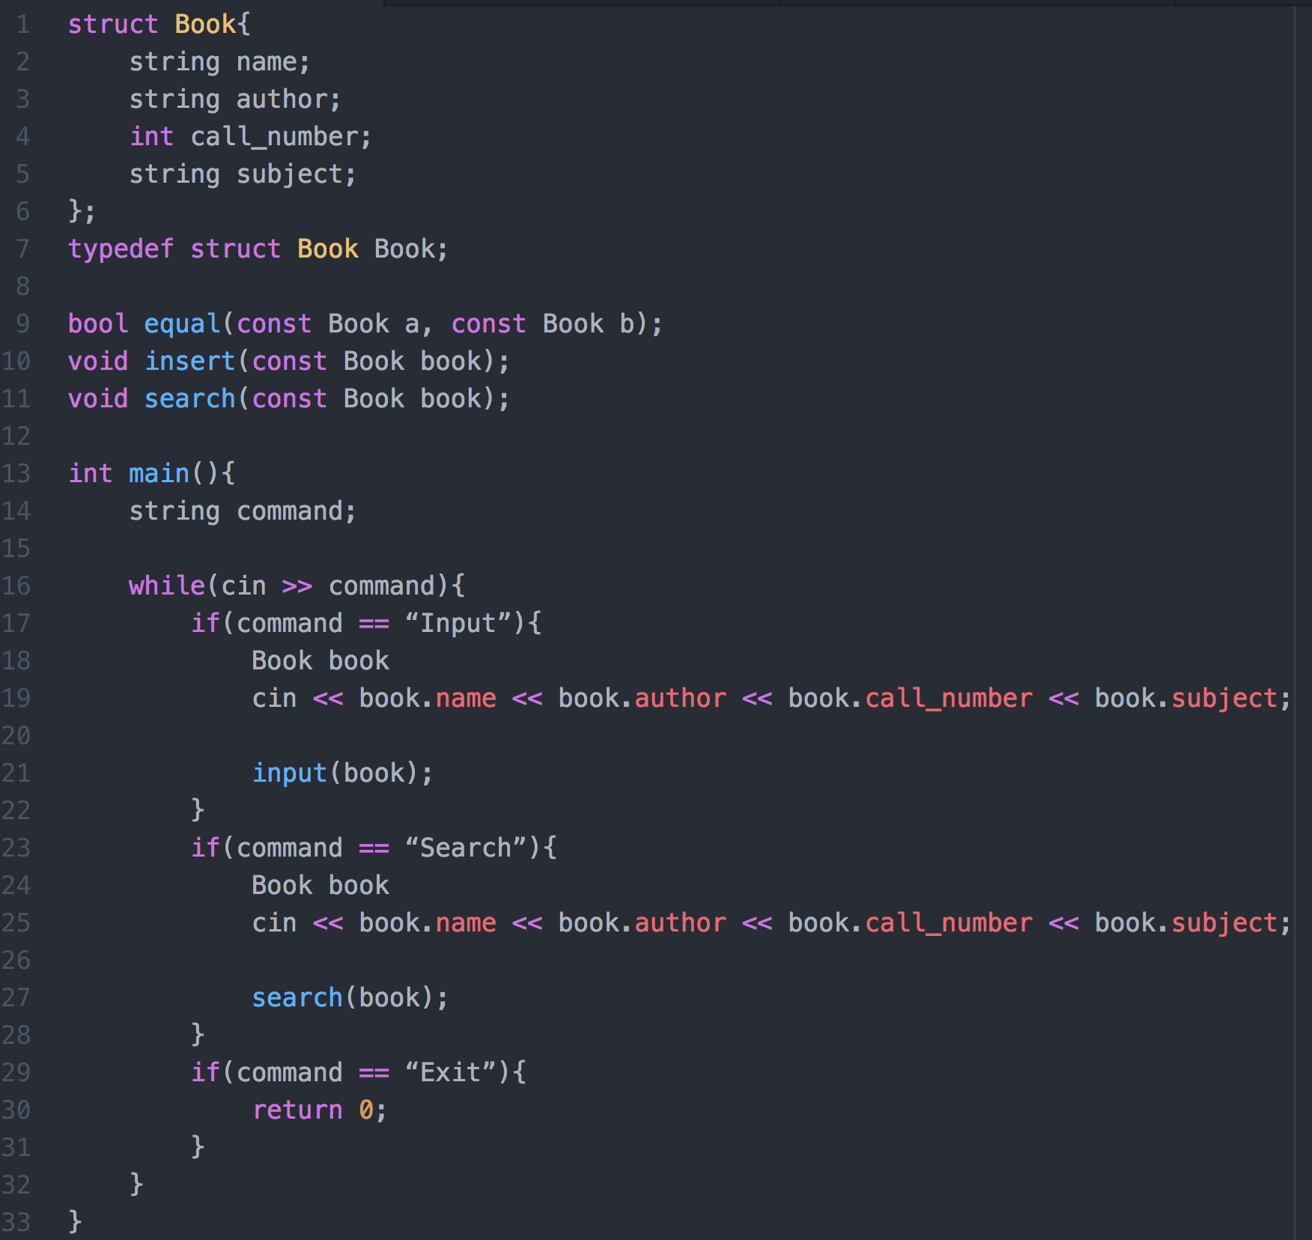
Challenge 1
<number>
Notes:
<number>

Slide 122
Challenge 2
This question is on file I/O and string manipulation.
Write a program to read a file and report the number of occurrences of each word in the file. Your program will not distinguish between upper- and lower-case words. E.g., “hello”, “Hello”, “HELLO” are the same. The words must be output in lowercase and sorted in ascending order of their frequencies. Words with same frequency are ordered lexicographically.
Example:
Contents of input file: Hello, where are you going to? Are you going to school to … say hello?
Your program output: say 1 school 1 where 1 are 2 going 2 hello 2 you 2 to 3
Hint: By including <cctype> you can use the function ispunct() to test whether a character is a punctuation or not.
<number>

